Slide 1




Toronto Football Club
DATA-DRIVEN REVOLUTION
IN SOCCER
Present by
Notes:
Manish 1-6

Slide 2
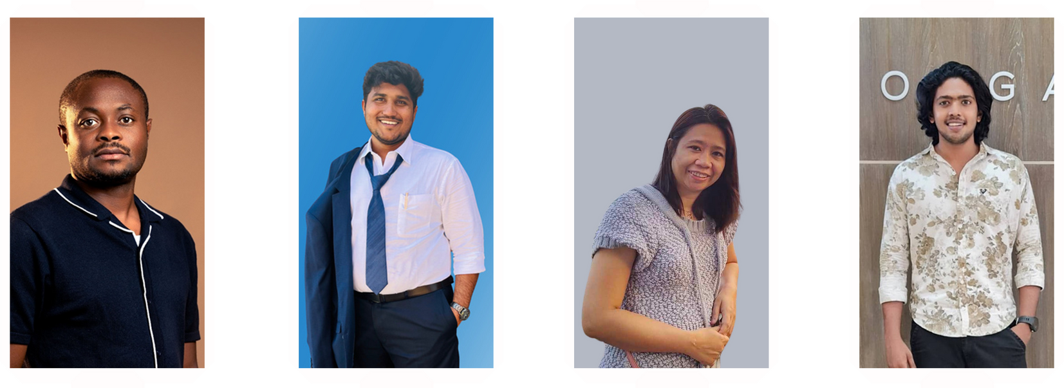
TEAM
CHIBUIKE
OKOROAMA
VENKATA MANISH
KATRAGADDA
PRESCILA
MORA
MOHAMED
AFTHAB

Slide 3


TODAY'S AGENDA
1
Project Overview
2
Quick Recap
3
Proposed Innovation
4
Concluding Insights
5
Q & A

Slide 4

FAN ENGAGEMENT
Boost loyalty and attendance through personalized insights.
TEAM PERFORMANCE
Provide strategic insights for optimal player and team strategy
PROJECT OVERVIEW
OPERATIONAL EFFICIENCY
Improve facilities and reduce costs through predictive analytics and data visualization

Slide 5
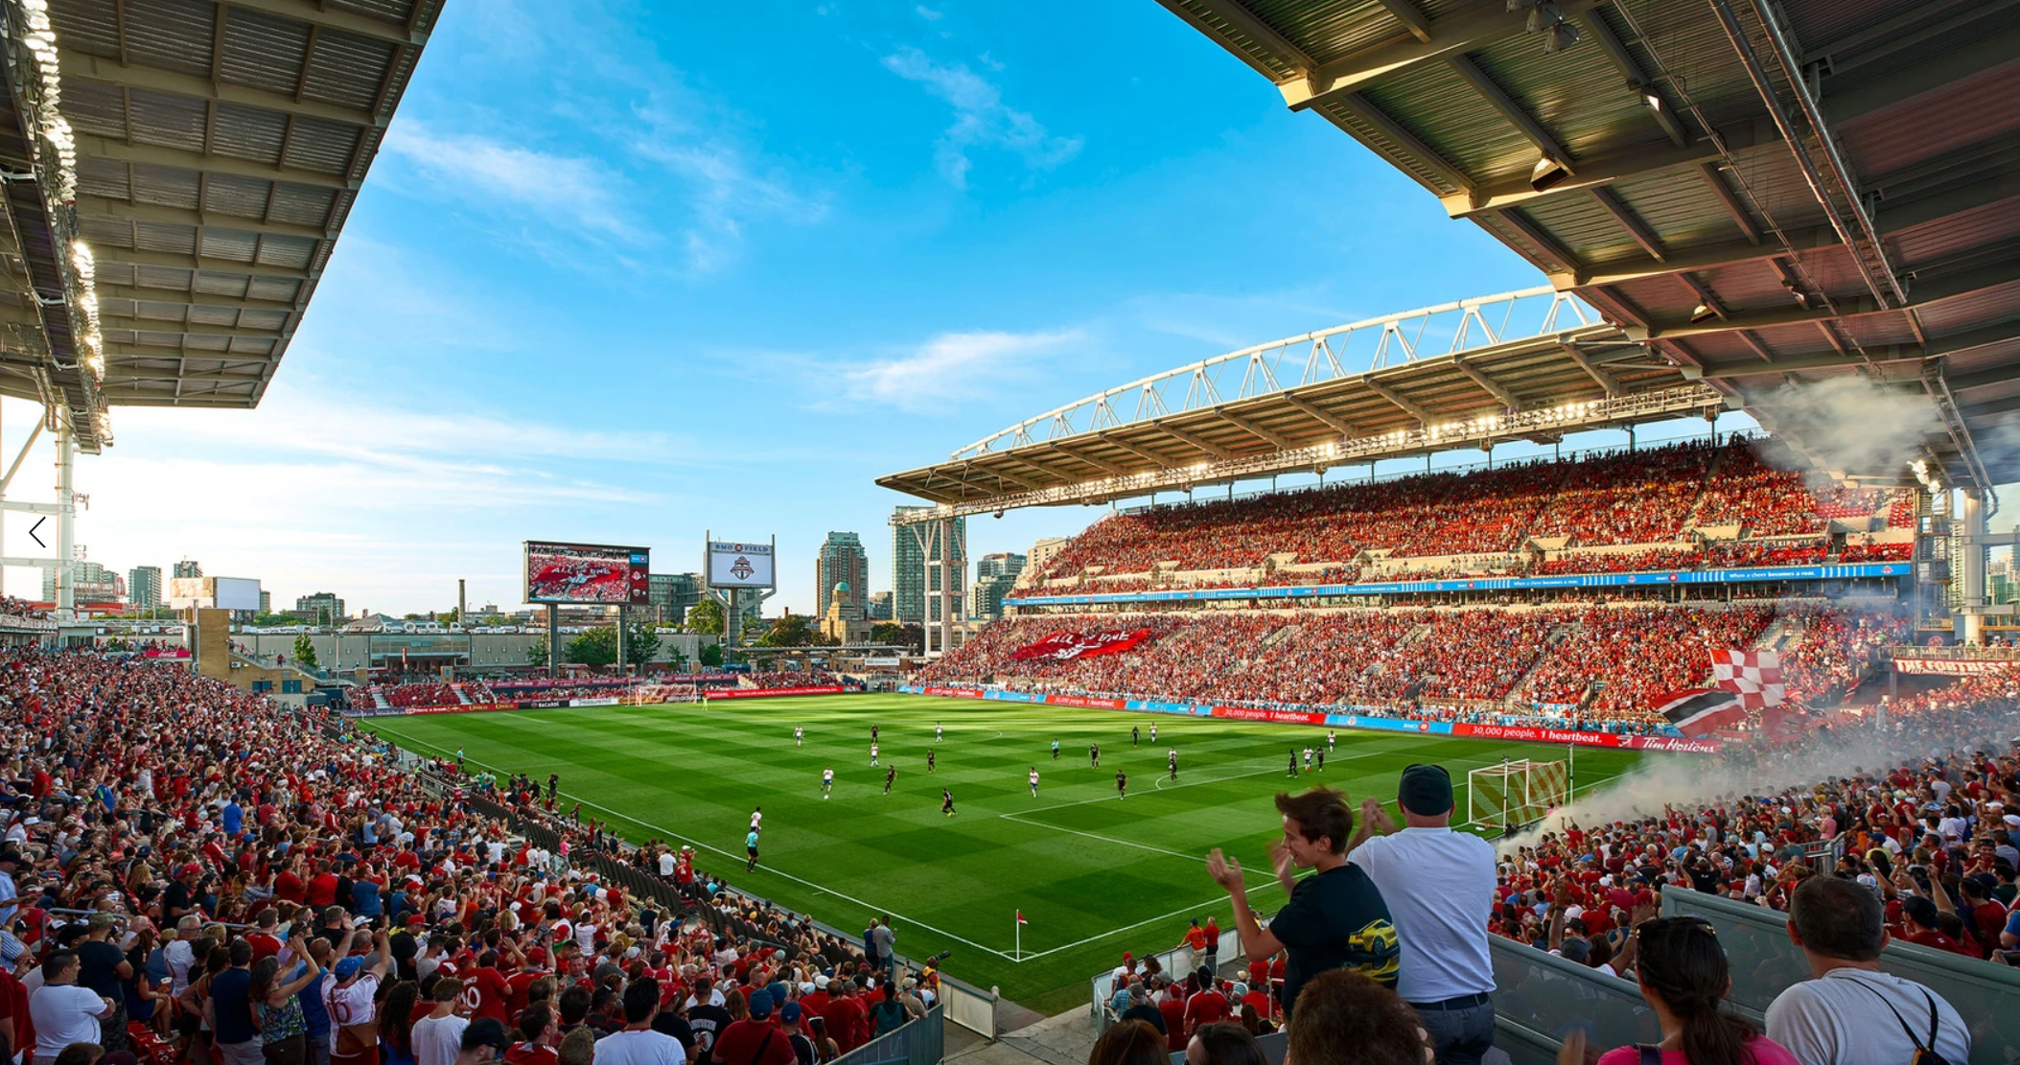

QUICK RECAP
FAN ENGAGEMENT SUCCESS
Social Media Analytics Implementation
Game Scheduling Optimization
Weather-Based Loyalty Program
Enhanced Game-Day Experience

Slide 6

INNOVATIVE SOLUTIONS
TEAM PERFORMANCE
DATA-DRIVEN INSIGHTS
Improve Possession- Based Strategy
Machine Learning
Game Insights
Gaining
Tactical
Advantage
Refined Player Metrics
Feature Extraction
AI-Powered Opponent Analysis
Game-Changing Insights
Predict Matched Outcomes
Dynamic Strategy Adaptation

Slide 7
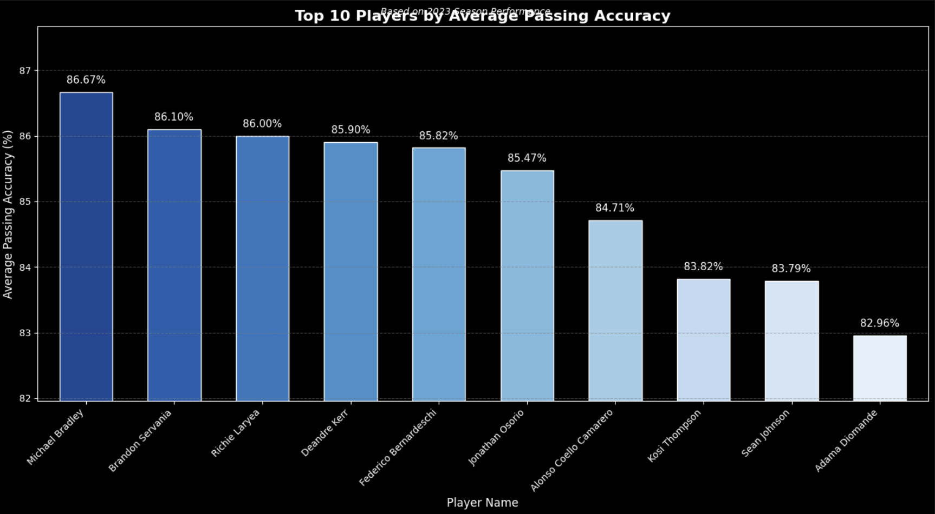
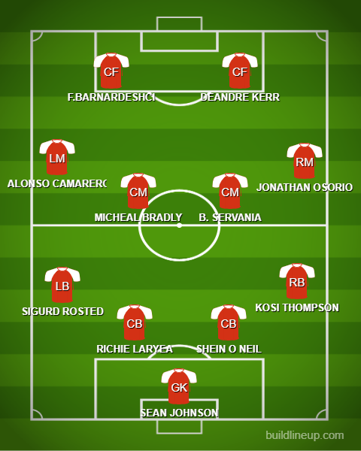
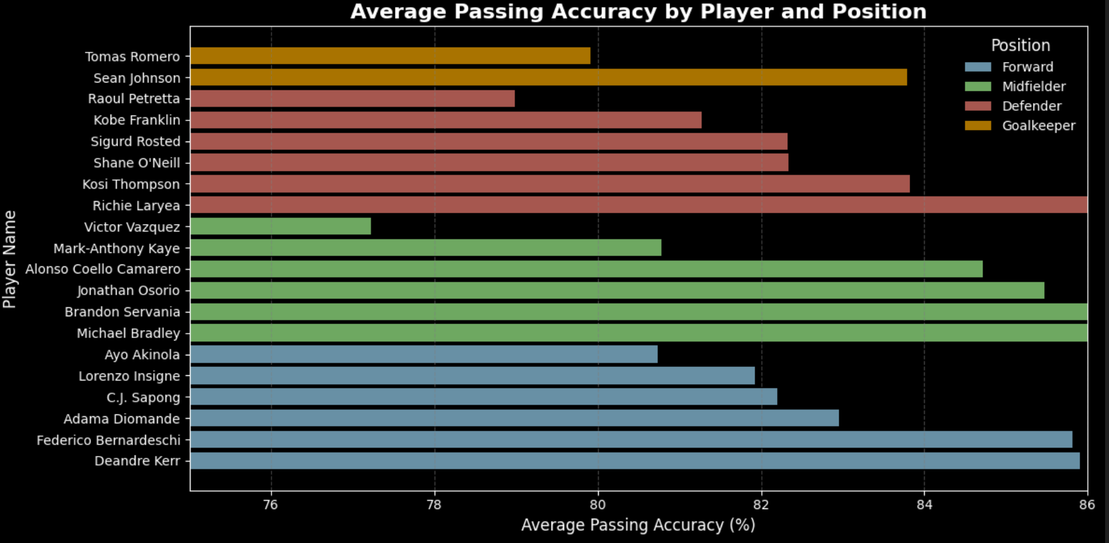
IMPROVED POSSESSION BASED STRATEGY
Notes:
Afthab

Slide 8
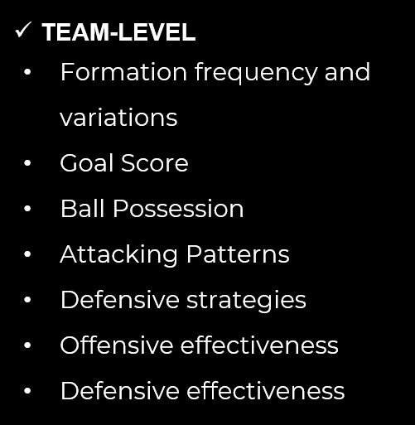
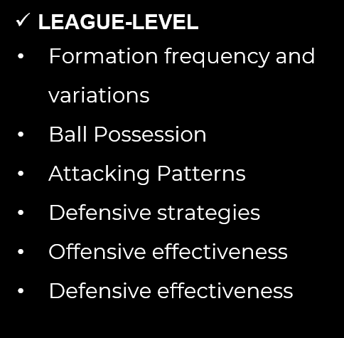
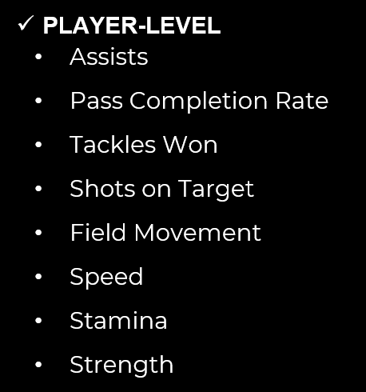
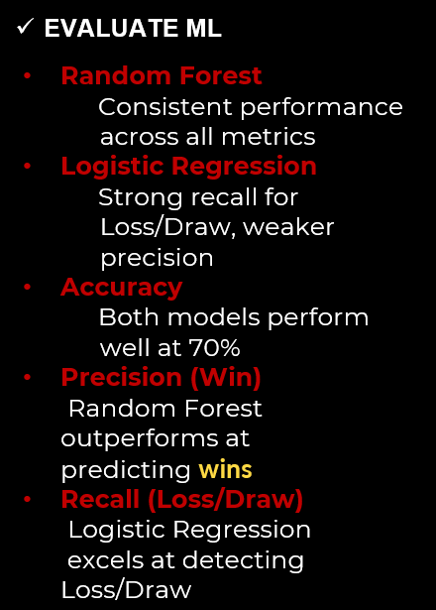
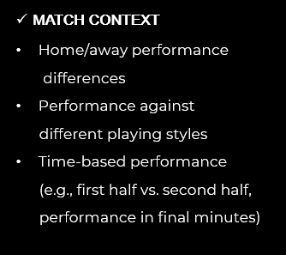
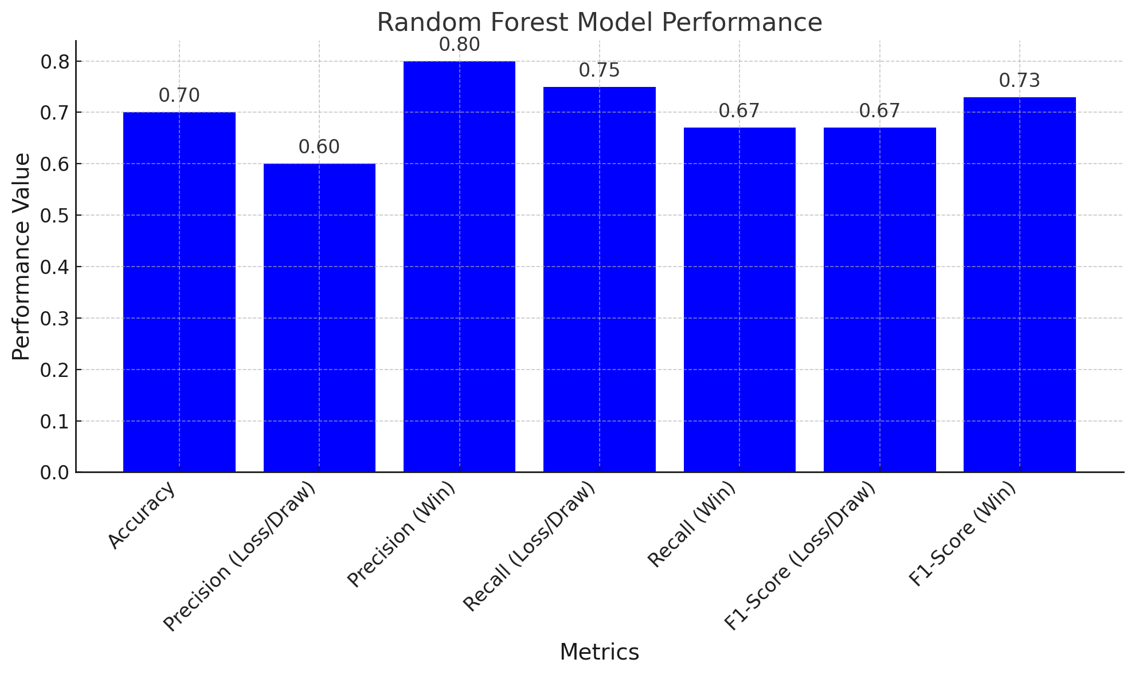
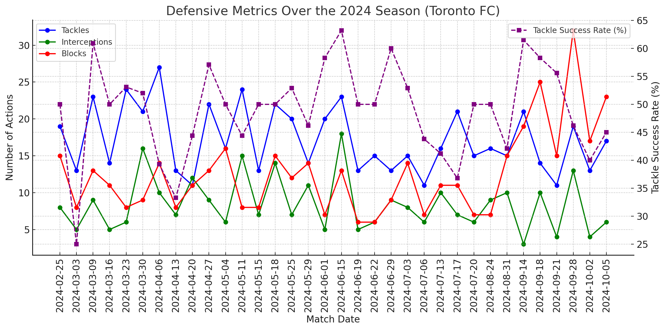
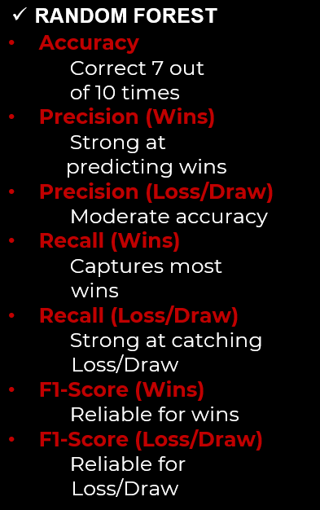
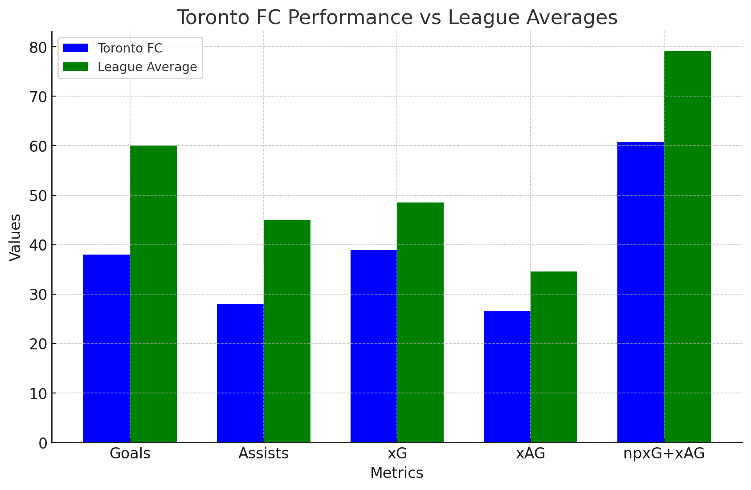
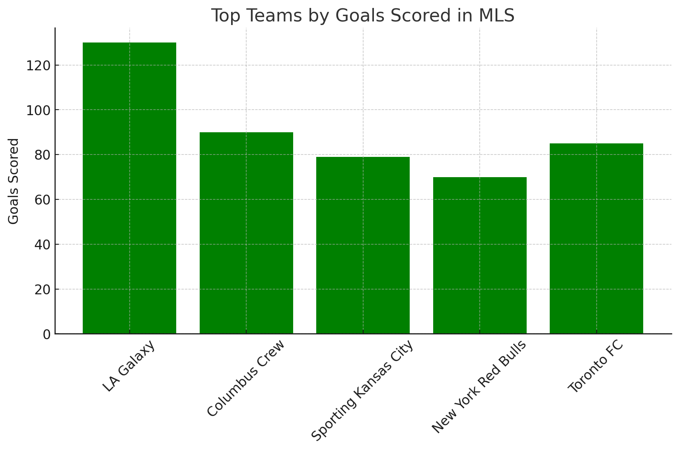
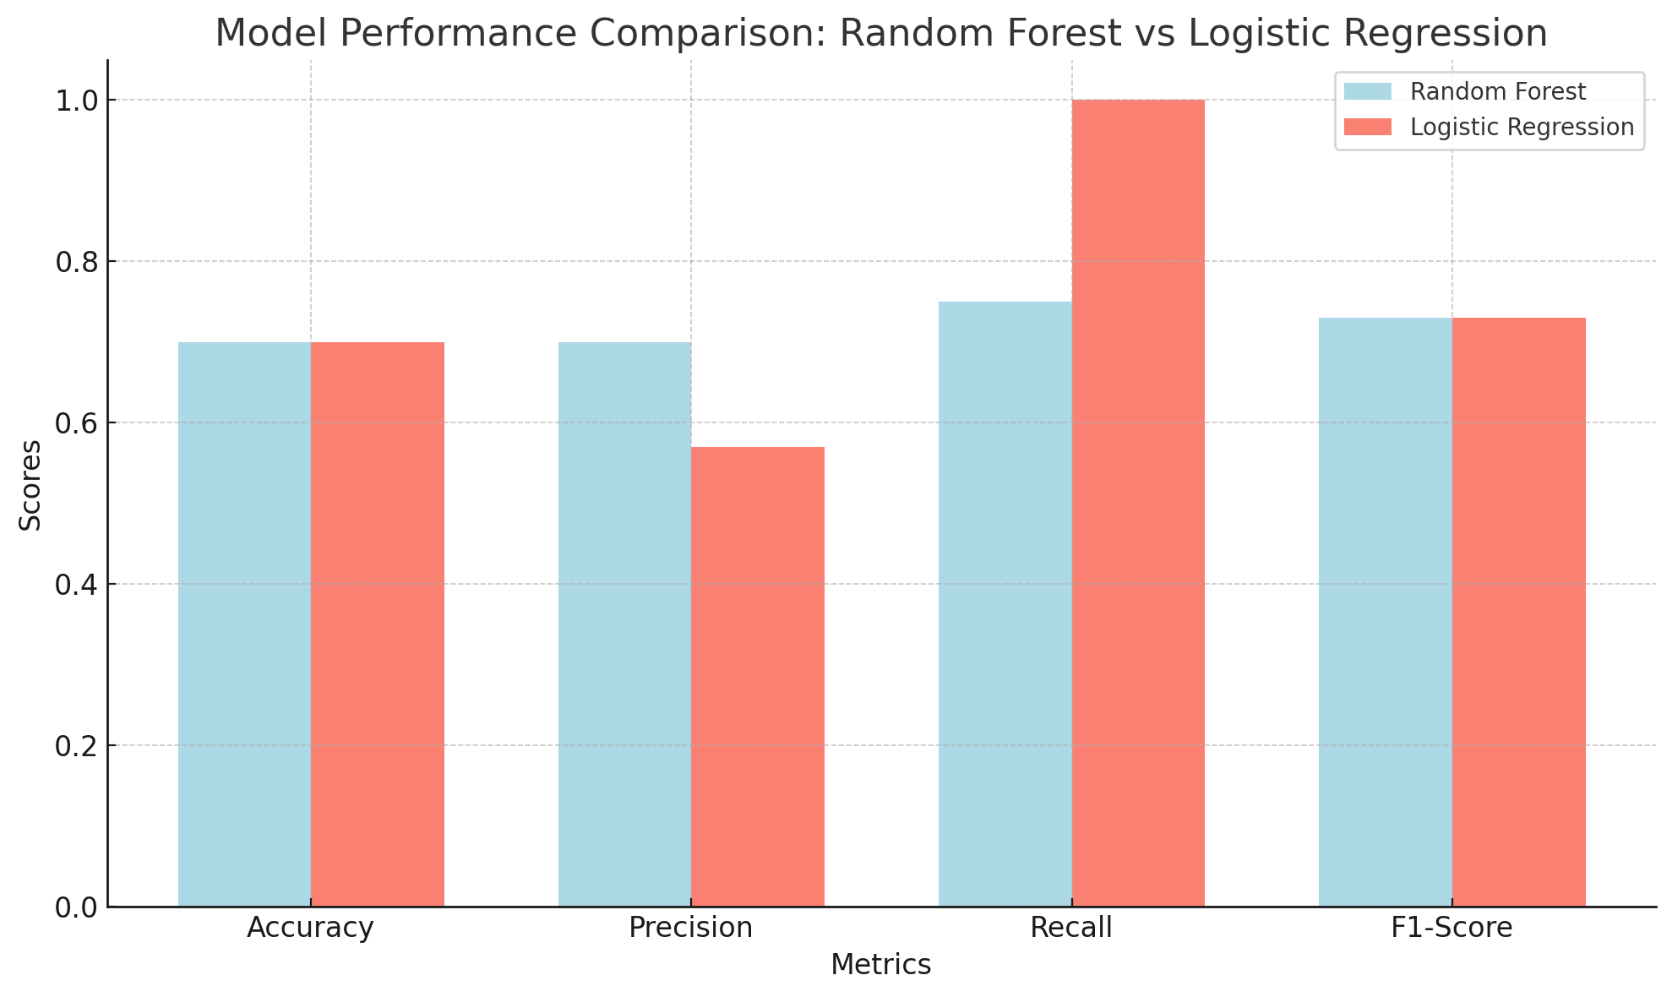
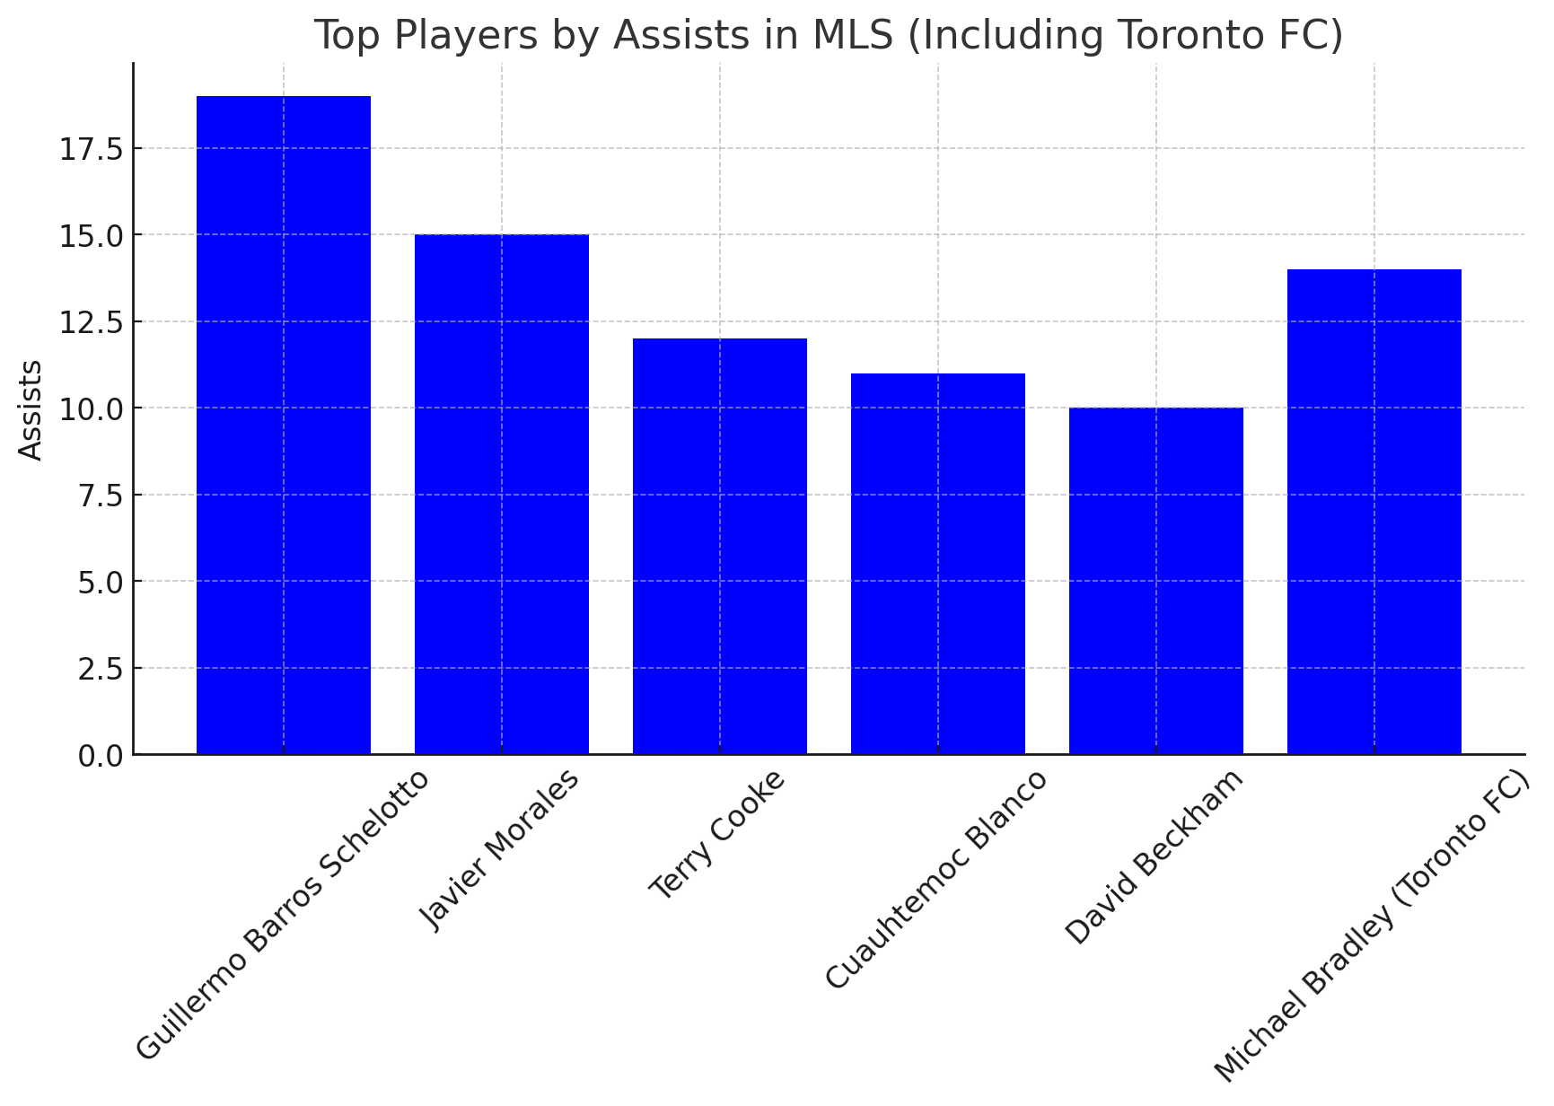
Machine Learning
Game Insights
Key Features and Predict Match Outcomes
Notes:
Prescila

Slide 9
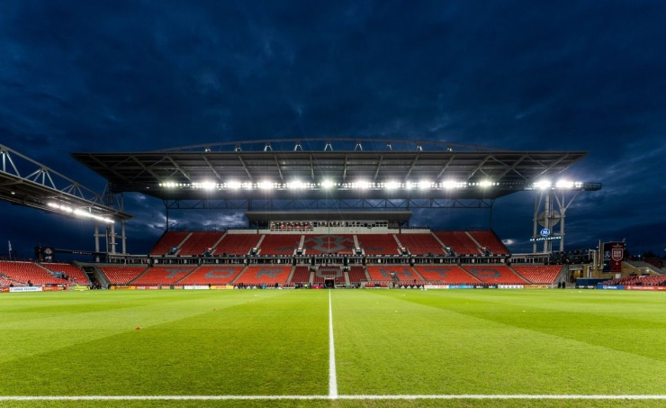
INNOVATIVE SOLUTIONS
OPERATIONAL EFFICIENCY
Smart
Energy Optimization
Predictive Maintenance
Sustainability and Compliance
Data-Driven Efficiency
Failure Forecasting
Environmental Monitoring
Cost Reduction
Cost-Effective Maintenance
Sustainable and Compliant Practices
Notes:
Chibuike 9 to 12

Slide 10
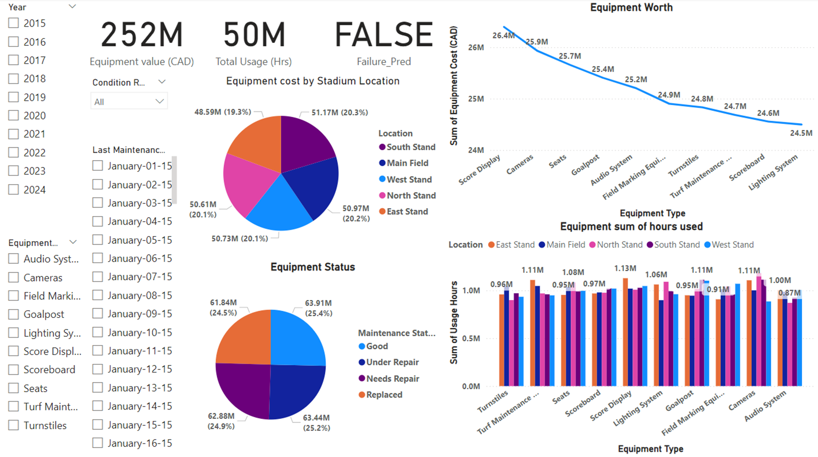
PREDICTIVE MAINTENANCE
98% Logistic regression model accuracy
AI generated Synthethic data
Notes:
Title: Transforming Toronto FC's Facility Management
Toronto FC is revolutionizing equipment maintenance with predictive algorithms, ensuring efficiency and cutting downtime costs.
Objective: Proactively predict failures to avoid costly emergency repairs.
Approach: Identified critical data like usage hours and condition ratings. Logistic Regression achieved 98% accuracy, highlighting key predictors like maintenance history and equipment age.
Results:
Predictive alerts enable timely interventions.
Optimized maintenance schedules reduce emergency costs.
A shift from reactive to proactive maintenance enhances reliability and efficiency.

Slide 11
IN A NUTSHELL
Transforming Fan Engagement
Cooper Incorporated utilized tools like Sprout Social and a weather-attendance algorithm to enhance fan loyalty through personalized interactions and weather-responsive strategies, ensuring consistent turnout and deeper connections.
Driving On-Field Excellence
AI-powered insights and clean data pipelines optimized player selection and tactics, giving Toronto FC a strategic edge while streamlining operations with AWS S3 for predictive maintenance and efficient management.
Future-Ready Innovation: By integrating scalable tools like Tableau and AWS, we provided Toronto FC with adaptable, data-driven solutions to lead in sports analytics and sustain long-term success.

Slide 12

REFERENCE
https://www.mlssoccer.com
https://fbref.com
https://www.whoscored.com
https://www.transfermarkt.com
https://www.sofascore.com
https://understat.com
https://www.statbunker.com
https://footystats.org
https://www.soccerstats.com
https://totalfootballanalysis.com
https://www.theanalyst.com
https://www.statsperform.com
https://www.kaggle.com
https://www.goal.com
https://spacy.io
https://kafka.apache.org
https://faker.readthedocs.io
https://flask.palletsprojects.com
https://www.jira.com
https://xgboost.ai
https://opencv.org
https://pandas.pydata.org

Slide 13


THANK YOU
Q&A
References
List of Toronto FC records and statistics – Wikipedia
Toronto FC Website

